Slide 1
Warm-Up - Citation Practice
The following case name is incorrect. Correct it:
United States, appellant v. The Long Island Railroad Company, appellee. Assume used in a citation sentence.
2. Frank E. Midkiff, Richard Lyman, Jr., Hung Wo Ching, Matsuo Takabuki and Myron B. Thompson, Trustees of the Kamehameha Schools/Bishop Estate, Plaintiff-Appellants, versus Paul A. Tom, Tony Taniguchi, Wilbert K. Eguchi, Wahne T. Takahashi, Commissioners of the Hawaii Housing Authority, Defendants-Appellees, a case decided by the United States Court of Appeals for the Ninth Circuit and reported in volume 702, page 788, of Federal Reporter, Second Series. What is the case name and case location? (e.g, Harrington v. Richter, 86 U.S. 562). Assume used in a citation sentence.

Slide 2

Lawyering Skills & Strategies
Drafting and Synthesizing Rules

Slide 3
Today in LSS
Love, Price, Whitehurst, and Tran LLP Presentations
Synthesizing and Drafting Rules
Don’t forget:
- -Complete Legal Research Modules 1.1-1.3 by 5:00 p.m. Today
Becoming a Legal Writer Ch. 4, ex. 4.1 and 4.4

Slide 4


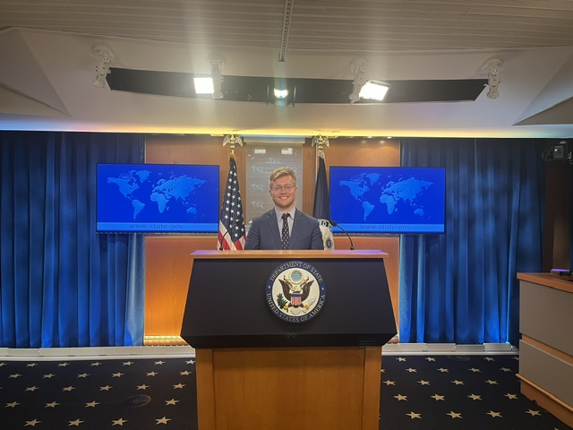
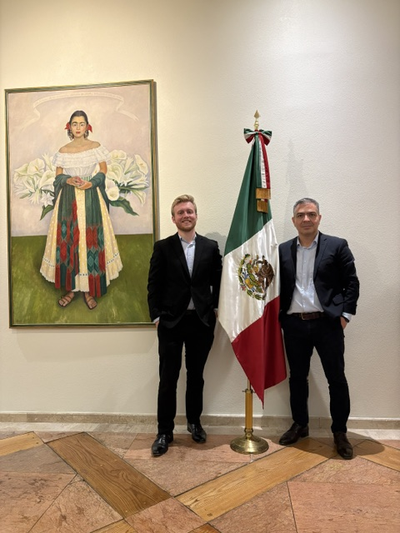

Rhett Price

Slide 5

Matthew love

Slide 6

About Me
I was born and raised in Atlanta, Georgia and am an avid sports fan of the Braves and Falcons.
In my free time I like to run, read, and spend time with my wife.
The last book I read was Dune Messiah.

Slide 7
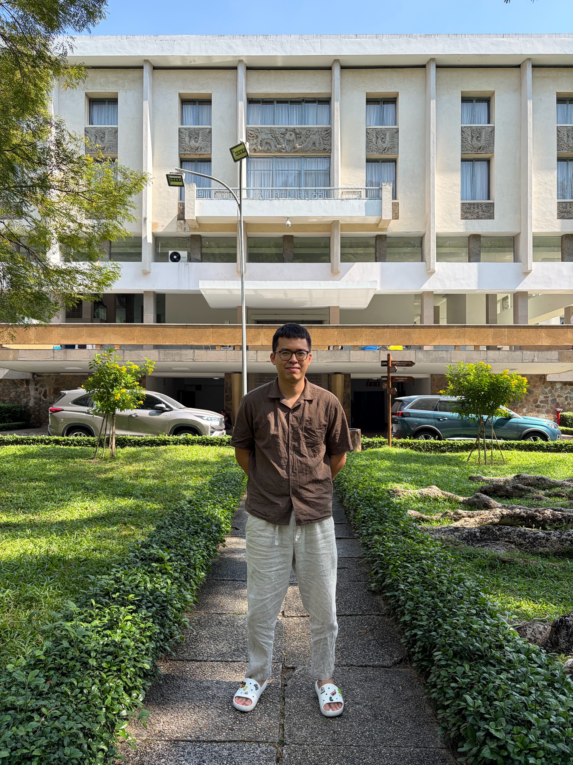
An Tran
Hometown: Saigon, Vietnam
In front of the former Presidential Palace of South Vietnam
Here to learn the Common Law
Interests: Endurance sports, Pickleball

Slide 8
Becoming a Legal Writer Ch. 4, ex. 4.1 and 4.4

Slide 9
Preliminary Analysis
What are we initially looking at for the preliminary analysis of a case?
What authorities do you have and what is the order of weightiness of them?
What is the issue presented?

Slide 10
Organizing your Legal Authorities
Where should you start?
What is the first section of your CREAC you should write?

Slide 11
Organizing Legal Authority
Case & Citation | Facts: Physical Presence | Facts: Intent Evidence | Governing Rule / Test Cited | Party Type / Posture | Holding on Domicile

Slide 12
What rules should you include?
Standards/tests/elements/factors that relate to your specific issue
Explicit rules (quotes are fine) when stated well or consistently by the courts
Implicit rules (what you observe courts doing) when necessary to fill in the gaps, so your reader has the whole picture

Slide 13
How do we narrow to the specific issue?
What are we going to be fighting with the other side about?

Slide 14
Correct!
Your Closed memo should focus on whether Fox acquired a new domicile in Kentucky or does he remain domiciled in Tennessee.

Slide 15
FIRST, inventory the INDIVIDUAL rules that go to your issue
(i.e., help the court answer your question)

Slide 16

Next, SYNTHESIZE…

Slide 17
The Rules You Gather Need to Become a
Synthesized Rule Statement
Because a judge is bound to decide cases based on stare decisis, it is the lawyer’s job to give the judge the entire picture of the state of the law in one, easily understandable standard.
A synthesized rule statement brings all the rule material together into one place, summarizing how the rules fit into a whole instead of listing the rules one at a time.
“By focusing on the reasoning and generic facts that the cases have in common, synthesis finds and explains collective meaning that is not apparent from the individual cases themselves.”

Slide 18
Finding consistency in seemingly inconsistent cases
When courts appear to reach opposite conclusions in cases that seem to have similar facts, do not assume that the decisions are inconsistent.
Look for a reason why the courts came to opposite conclusions.
  For example, you may notice that every time a certain fact is present, the court reaches a particular conclusion.
Even when decisions seem inconsistent, it is your job to find a common denominator to make the decisions consistent.

Slide 19
Then, put it all together (Synthesize)
Start with the broadest test, usually common to all of the cases in a particular area of law (e.g., the gain admission to the Bar, a person must demonstrate good moral character and general fitness to practice law)
Next, describe sub-rules or specific elements or factors. Sometimes these build up as part of the snowball effect of several different cases. (e.g., good moral character includes righting past wrongs and staying out of trouble)
Avoid describing how the law came to be (e.g., the court in X held that ____, but in 1962, the court changed course).
Instead, describe only what the law is now.
Use present tense.

Slide 20
Drafting Your Synthesized Rule Statement
Go broad to narrow / general to specific
  broad/general = top level legal standard
  narrow/specific = individual elements or factors
Do not mention specific facts. Rules are generic and universal.
Do not write a list.
Quote explicit rules when you can.
Paraphrase implicit rules and for succinct and interesting writing.
Do not change terms of art.

Slide 21
Sample Rules Paragraph
Under Georgia law, “a person shall be guilty of carrying a weapon or long gun in an unauthorized location and punished as for a misdemeanor when he or she carries a weapon or long gun while . . . [i]n a place of worship . . . .” Ga. Code Ann. § 16-11-127(b)(4) (West 2013). Although the term “place of worship” is not defined in the statute, Georgia courts consistently look to the primary use of property, not merely its ownership, to determine if the property constitutes a “place of religious worship” under a similar ad valorem taxation statute. Roberts v. Ravenwood Church of Wicca, 292 S.E.2d 657, 659 (Ga. 1982). If a place is open to the public and is primarily used for a congregation to assemble to pay reverence and homage to a deity, then it is a “place of worship.” Leggett, 205 S.E.2d at 201. For Catholicism, this would include saying prayers, singing hymns, reading scriptures, and the giving of testimonies and sermons in a congregational setting. Id. at 200. It would also include the traditional sacraments and rites of baptism, marriage, communion, and funeral services. Id.

Slide 22
Your Turn: Write a Rule Paragraph
Lay out the general and specific rules for our issue, progressing from broad to narrow.
Use proper citation
Notes:
This is a short version of what you’ll be doing with your memo.
Print Eric Hypo for them

Slide 23

For Thursday
Work on Closed Memo Discussion section (due Sunday, 9/20 at 5:00 p.m.); you should start drafting your Rule Statement at this point
Research Modules 1.1-1.3 due today at 5:00 p.m.
Read BLW Ch. 7 intro., page 125, Ch, 7.1, intro. and §§ I-II (pp. 127-130), Ch. 7.2, §§ I-III (pp. 147-149)
Complete BLW Exercises 7.1.1, 7.2.1, and 7.2.2
Complete selected ICWs from Exercises 3 and 5 (look for the selected problems in Canvas Week Three Module) by Sunday, 9/13 at 5:00 p.m.

